Slide 1

Cool T Shirts Touch
Attribution
Mapping Customer Journey with Marketing Data
Parshva Jhaveri
29-01-2025

Slide 2
Table of Contents
Familiarization with existing data
User Journey- First and Last Touches
Purchase related data
Findings.

Slide 3
1. Familiarisataion with existing data

Slide 4
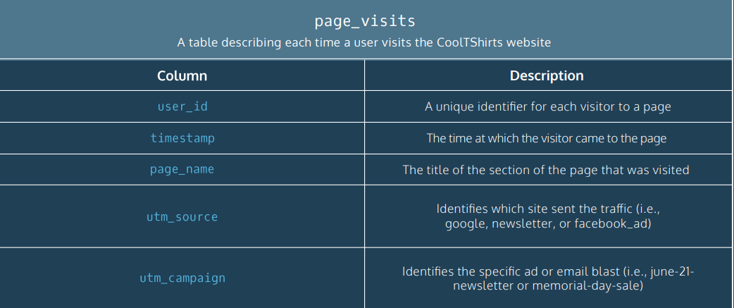
1.1 DB Schema

Slide 5


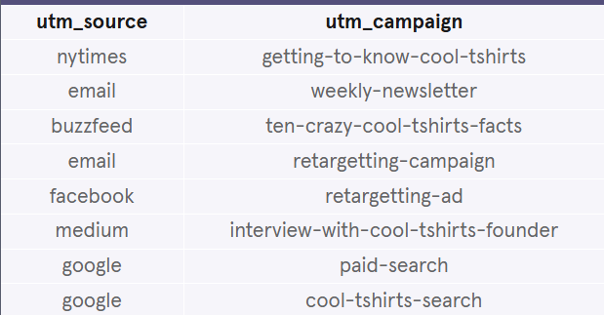

1.2 Campaigns and Sources
Using basic queries, I was able to find answers to the below questions:
How many campaigns and sources exist?
How many pages exist on the Cool T Shirts Website?
How are the campaigns and sources related?

Slide 6
2. User Journey- First and Last touches

Slide 7
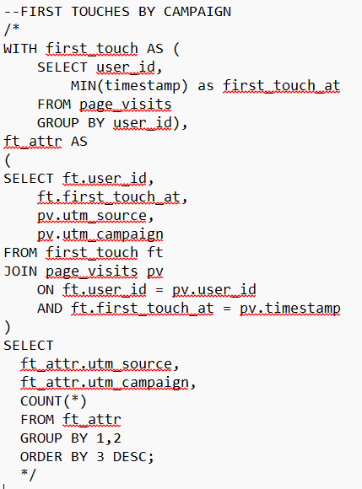
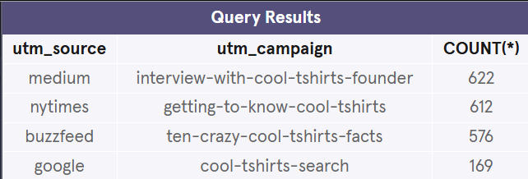
2.1 First touches by campaign type
Counts the first touches each campaign generated.

Slide 8
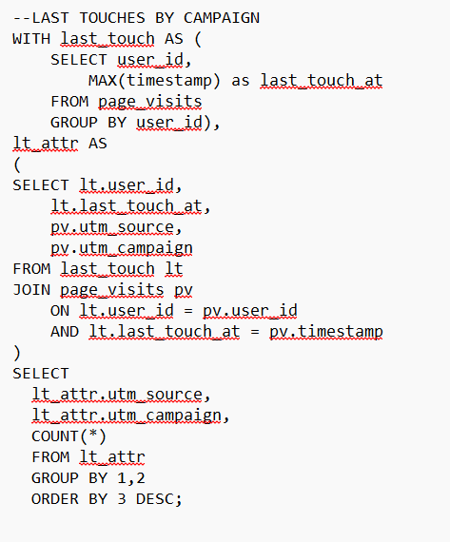
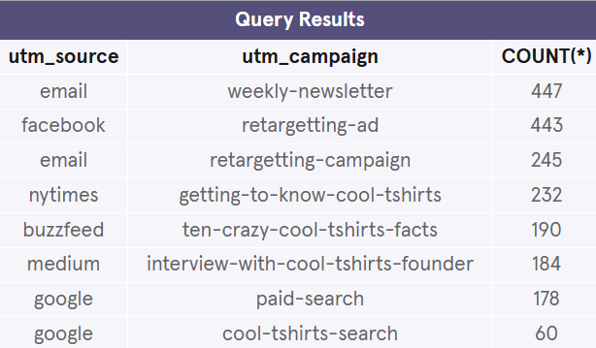
2.2 Last Touches by campaign type
Counts the first touches each campaign generated.

Slide 9
3. Purchase related data

Slide 10
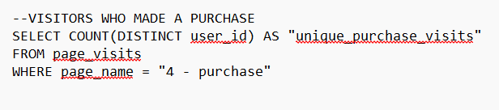

3.1 Purchases made
Counts the unique number of visitors who visited the purchase page of the website.

Slide 11
4. Findings

Slide 12
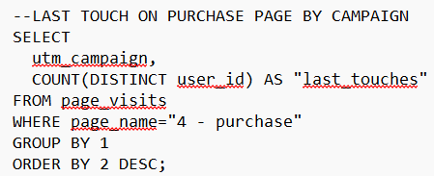
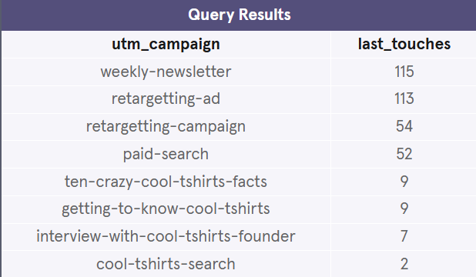
4.1 Last touches on purchase page by campaign type
Let’s find which campaign resulted in the highest number of last touches on the purchase page.

Slide 13
4.2 Actionable insights
Cool T Shirts can re-invest in 5 of the 8 existing campaigns. From 4.1 we can clearly see that the top 5 campaigns resulted in the maximum number of purhcases.
Consequently, Cool T Shirts should consider re-investing in the following campaigns:
Weekly-newsletter
Retargetting-ad
Retargetting-campaign
Paid-search

Slide 14
Appendix
UTM Parameters: Refer to this link to learn more.
First-touch attribution assigns credit for a conversion to the first interaction a customer has with a brand. It helps identify how customers initially discover a website.
Last-touch attribution gives credit to the last interaction before a conversion. It shows how customers are drawn back to a website to make a final purchase.
Both methods provide insights into different stages of the customer journey and are used to optimize marketing strategies.

